Slide 1
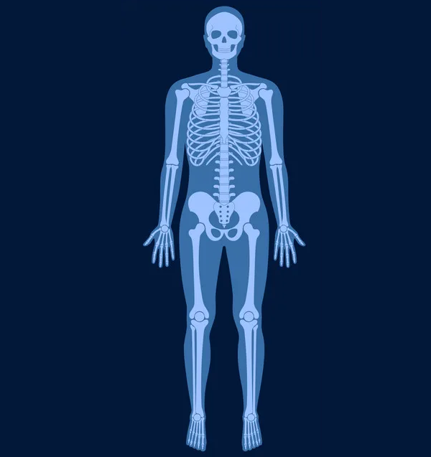
Harborview X-Ray
Charges ’23
Skull: $575
Shoulder: $475
Chest: $443
Elbow: $460
Pelvis: $557
Hand: $657
Hip: $453
Femur: $316
Knee: $468
Tibia: $450
Ankle: $523
Foot: $539
Notes:
2023 – minimum number of views – Harborview – Default Price
https://www.vectorstock.com/royalty-free-vector/skeleton-x-ray-vector-31748523

Slide 2
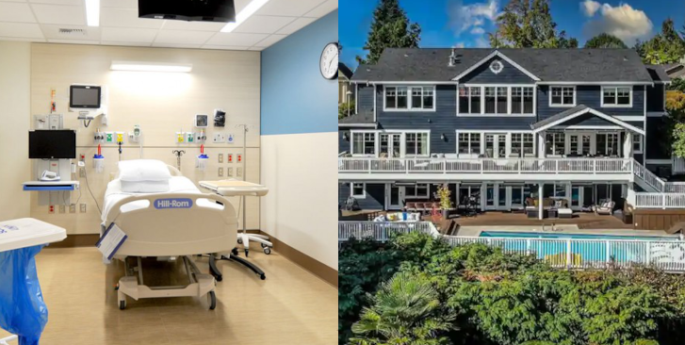
Hospital Room VS AirBnb (per night)
$3,264
$999
Notes:
Level 1 R&B Harborview: $3264
AirBnb Seattle: $990
https://www.airbnb.com/rooms/949350333467771973?check_in=2024-09-03&check_out=2024-09-05&guests=1&adults=1&s=67&unique_share_id=2f5992fb-05a3-4f06-9991-e3bcbbce0f86
https://www.andersen-const.com/portfolio/project/harborview-medical-center--maleng-single-patient-room-project

Slide 3
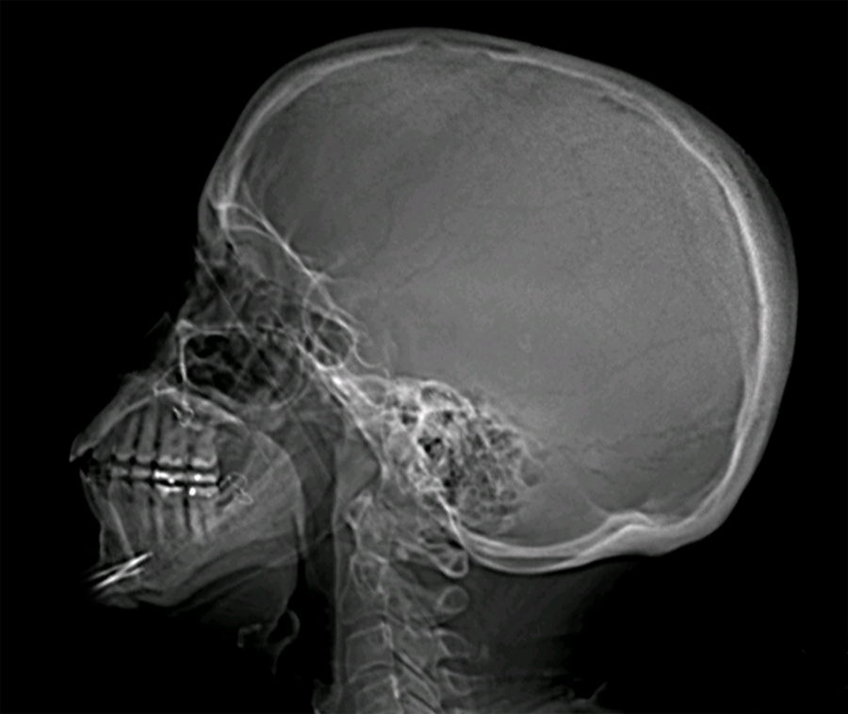
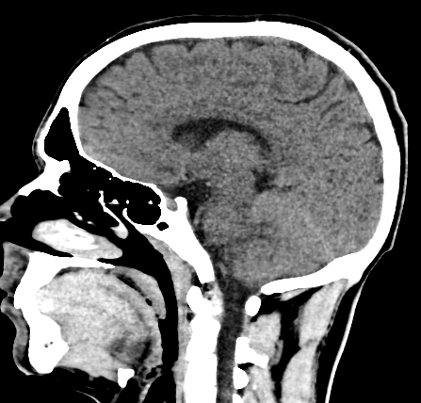
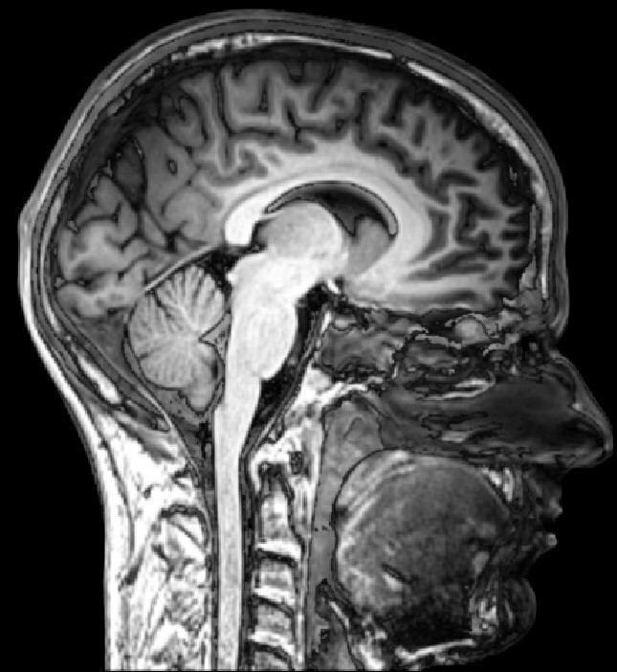
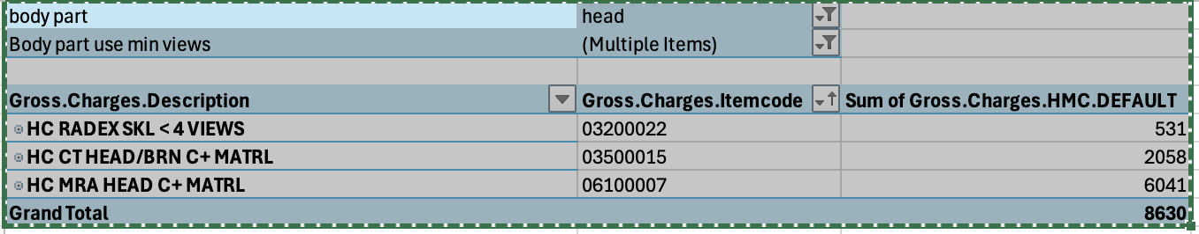
Head imaging
X-Ray
CT
MRI
$531
$2,058
$6,041
Notes:
Harborview 2023 charges
X-Ray = Skl <4 Views 3200022
CT = CT Head/BRN C+ MATRL 3500015
MRI = MRA Head C+ MATRL 6100007

Slide 4
Compare xray/L&D/R&B/ED Visits/etc to other hospitals
Show range of OP payor prices for a service / Compare payor prices
Show difference between Xray / CT / and MRI
Hospital room R&B compared to luxury hotel suites.
Show common drug costs
Common lab tests (POCT blood glucose, pregnancy test, etc…)

